Slide 1

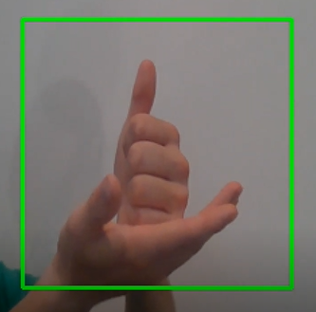

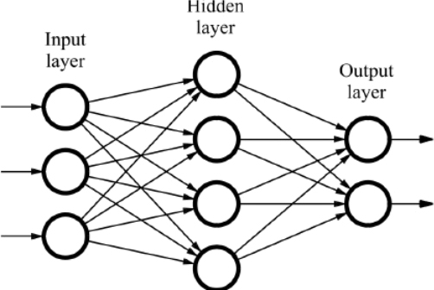
Real Time Sign Language Classification
Ben Suffin Bo Zhang Tyler Reece

Slide 2
Agenda
Problem Overview
Data collection and dataset description
Models
Classification Results
Challenges
Future Work
Conclusion and Questions

Slide 3
Problem Overview
Over half a million people in the US have disabling hearing impairment, 3rd most used language in the country
Communication done through sign language, writing, or text-to-speech
Real-time systems for sign language allow more natural communication from hearing impaired individuals to those who do not know sign language
In the subdomain of machine vision problems
Previous work done usually uses CNNs (Garcia et al¹, Dinesh et al²)

Slide 4

Data Collection
Using a Python script with OpenCV
Pictures were taken ~ 36 ms
Extremely time consuming (~3 minutes per class)
Saved into folders by class
Preprocess script cropped and converted to black and white for model use
Tyler’s hand got very tired during the dataset collection process

Slide 5
Dataset Description
Alphabet
24 Classes, A-Z (excluding J and Z)
5000 images per class, clean background
Words
7 Classes, common simple words (static signs)
1000 images per class, clean background
All images preprocessed into 50 x 50 pixel black and white images

Slide 6












A
E
H
L
V
Y

Slide 7














HOUSE
OK
MORE
HELP
LOVE
WITH
FRIEND

Slide 8
Models - k-nearest neighbors (KNN)
One of the simplest non-parametric supervised learning method
K parameter selecting: balance between noise reduction and data distinction
Feature selecting and scaling
Pros
Easy to implement
Strong consistency results (error rate no worse than twice the Bayes error rate)
Cons
Computationally intensive for large training sets, low learning rate (slow convergence)

Slide 9
Models - support vector machine (SVM)
Goal: find hyperplane based off of maximized margins of data points that allows for classification of an N-dimensional dataset
Use cost function and update gradients to determine classifications
Pros
Easy to implement (sklearn)
Strong consistency results
Works well in large dimensional spaces
Cons
Computationally intensive for large training sets, tedious run times
Can have difficulty creating boundaries between overlapping classes

Slide 10
Models - convolutional neural network (CNN)
Ideally suitable for image and voice recognition with multilayer structure and less requirement for data preprocessing
Pros
Robust with various features and noisy environment
Efficiently extract important ones from various features by rotating, flipping images, reducing complexity
Cons
Fully connected, prone to overfitting data

Slide 11
Classification Results
Performance Score | KNN | SVM | CNN
Precision | 0.99354 | 0.99951 | 0.99637
Recall | 0.99306 | 0.99951 | 0.99625
F1-Score | 0.99309 | 0.99951 | 0.99630

Slide 12
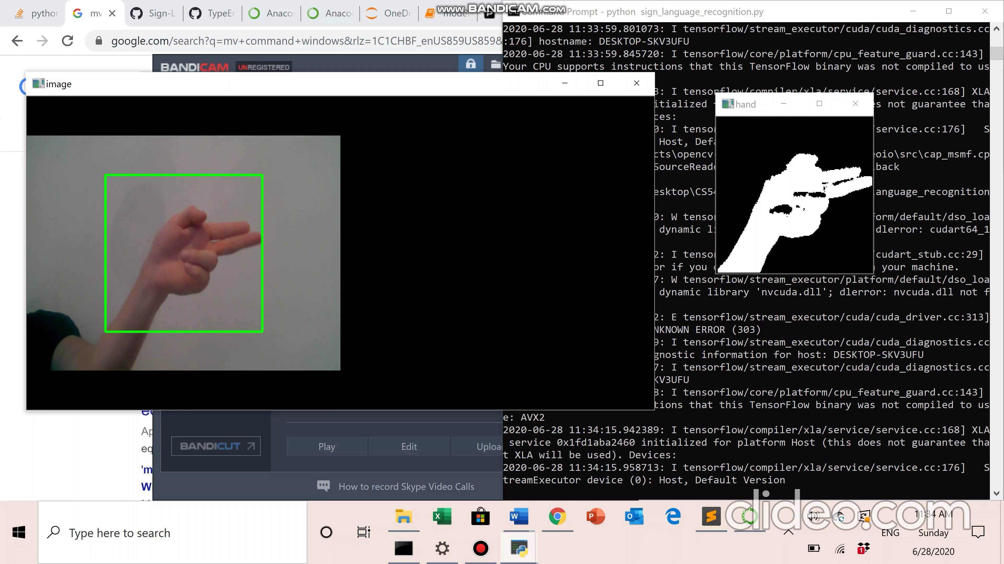
Real Time Classification Demo

Slide 13
Challenges & Lessons Learned
Data collection was difficult, time consuming
Performance and cost with large datasets
Similar looking signs, especially in the alphabet dataset
Signs with movement (non-static)
Model robustness to noisy environments, lighting, movement
Good performance in model testing does not necessarily equate to good performance in real time classification

Slide 14






Can you tell the difference?

Slide 15
Future Work
Adding in non-static signs (train on short video clips)
Adding in noisy backgrounds, blurriness, movement, lighting variation
Signs that require more than hands
Further study of how expanding the number of classes affects accuracy
Methods to improve speed of real-time classification

Slide 16
Questions

Slide 17
References
http://www.ijirset.com/upload/2018/ncetdst/40_REAL-TIME%20AMERICAN%20SIGN%20LANGUAGE%20RECOGNITION%20WITH%20FASTER%20REGIONAL%20CONVOLUTIONAL%20NEURAL%20NETWORKS.pdf
https://link.springer.com/article/10.1007/s00521-019-04691-y

